Slide 1
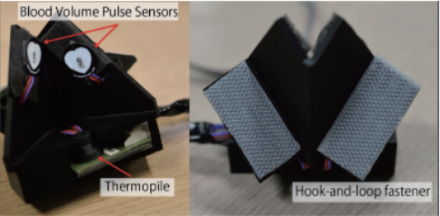
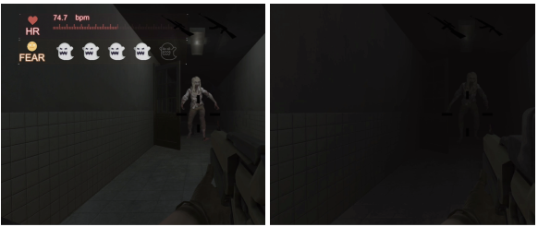
Interactive VR System using Biological Information Measuring Devices
Interactively change the content of VR using user’s state of being
Use respiration and pulse wave measurement devices attached to the head mounted display
Integrated into a horror game where the view of the player changes based on their level of fear
Masahiro Inazawa, Xianyin Hu, and Yuki Ban. 2019. Biofeedback Interactive VR System Using Biological Information Measurement HMD. In SIGGRAPH Asia 2019 Emerging Technologies (SA '19). Association for Computing Machinery, New York, NY, USA, 5–6. DOI:https://doi-org.libproxy.furman.edu/10.1145/3355049.3360523

